Slide 1
Connect Four AI
Jonathan Lehman

Slide 2
Game Theory
Zero-sum games
Tic Tac Toe – 9! states
Connect Four – 10¹³ states
Checkers – 10¹⁸ states
Chess – 10⁵⁰ states
Game State
Game Tree
Minimax
Negamax
Evaluation Function
End game lookup table – hash table
Notes:
bruteforce

Slide 3
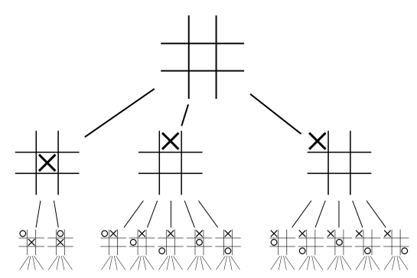
Game Trees
Notes:
Each game state is a node, edge move

Slide 4
MiniMax
int minimax(state, depth, maxPlayer) if(depth == 0 || gameOver(state)) return evaluate(state, maxPlayer) best = -INFINITY for move in getMoves(state) score = minimax(state, depth, maxPlayer) if score > best best = score bestMove = move
return best

Slide 5
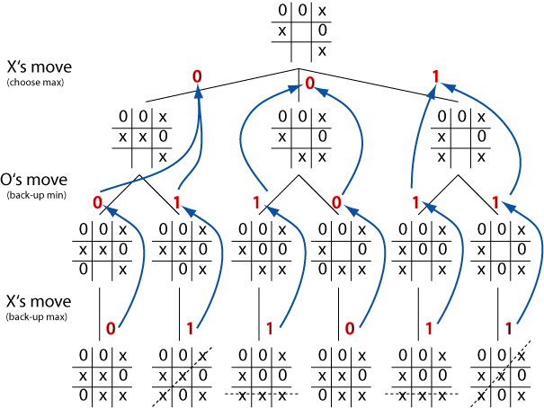
Minimax Example

Slide 6
Evaluation Function
Determines value of game state
Game not fully played out
Reached max depth
Responsive AI – responds in a timely manner
Not enough time to play out full game
Chess – not solved
Connect Four
Squares in the center worth more
Longer connections worth more

Slide 7
Connect Four on GPU
Generate move combinations in parallel (each thread)
Based on block and thread id’s (similar to N queens)
Generate 8 moves (i.e. depth = 8)
Grid size = (board width³)²
Block size = board width²
3 general strategies
Recursively
Best Moves Combination (optimistic)
First Move Total (based on first move)

Slide 8
Get Score Per Move Set
__shared__ moves[tx][ty][numMoves] = generateMoves __shared__ evals[tx][ty][numMoves] = 0 for move in moves if canMove(board, move) doMove(board, move, player) if noWinner(move) evals += evaluate(board, player) else move = blockOrWin(move, board, player) changePlayer(player) else eval = -invalidScore syncThreads()

Slide 9
Get Block Sums per Start Move
If threadID == 0 for each thread in block scoreArray[index] += evals[firstMove]
syncthreads

Slide 10
Get Sub Grid Sum Per Start Move
If blockID == 0 work, start //based on threadID for start to (work + start) evals[move] += scoreArray[index] syncthreads

Slide 11
Get Grid Sum Per Start Move
for threads in block0 finalScores[move] += evals[move]
syncthreads

Slide 12
Compare and Get Best Move
bestOverallMove bestScore = -invalidScore for each start move if finalScores[move] > bestScore bestScore = finalScores[move] bestOverallMove = move
move = bestOverallMove

Slide 13
Depth 8 Results
Empty Board
CPU: 1.956 second average
GPU: 0.506 second average
One Move Left
CPU: 0.0001 second average
GPU: 0.182 second average

